Slide 1

Information Security Updates
AGENDA
HealthEquity, Kairos Health Arizona, Ambulnz, and Texas Retina Associates suffer data breaches
NIST CSF 2.0 Risk Assessment Results KPIs
NIST CSF 2.0 Risk Assessment Results Gaps
Tactical Information Security Roadmap
Strategic Information Security Roadmap

Slide 2

Current Breach News
HealthEquity
What happened: HealthEquity recently identified anomalous behavior in a business partner’s device, and said the initial investigation indicates that the device had been compromised and was used to access members’ information. It was determined the extent of the breach, which revealed an unauthorized actor accessed and exfiltrated HealthEquity’s SharePoint data
Cause: Compromised device
Impact: ~ 165,800 records exposed
Lessons to learn: Ensure there is appropriate logging and monitoring, and incident management is effective through proper training and exercises.
Ambulnz
What happened: Ambulnz, a subsidiary of DocGo providing medical transportation service, suffered a cyberattack that exposed ePHI.
Cause: Unauthorized access to the network
Impact: ~ 4,742 records exposed
Lessons to learn: Ensure there is network segmentation and all network devices and servers are patched with current updates.
Kairos Health Arizona
What happened: Kairos experienced a data breach due to unauthorized access by a former third-party vendor who accessed and downloaded member data. The ePHI included names, insurance ID numbers, claims/coverage information, and other health information.
Cause: Unrevoked former 3rd party access
Impact: ~ 14,364 records downloaded
Lessons to learn: Ensure all third-parties are known and revoke access after the contract agreement is terminated.
Texas Retina Associates
What happened: Texas Retina Associates suffered a significant data breach resulting in a threat actor gaining access to the network.
Cause: Ransomware attack
Impact: ~ 312,000 records exposed
Lessons to learn: Ensure the continuation of phishing training and email controls to reduce the likelihood of a ransomware attack.

Slide 3
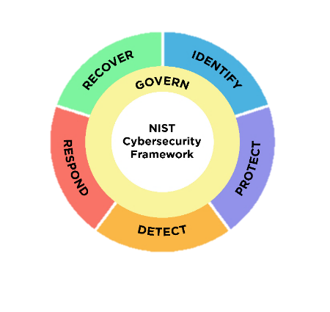
NIST CSF 2.0 Risk Assessment Results KPIs
Overall Average
3.4
0 critical
1 highs,
10 moderate
7 lows
Notes:
We use the NIST CSF to measure our organization against a solid framework used by many organizations to identify and mitigate risks. The goal is to reduce risk to an absolute acceptable level. The framework has 106 controls spread across 6 functional areas. Govern, Identify, Protect, Detect, Respond, and Recover. The outcome is to find our risks, determine risk treatment, Avoid, Mitigate, Transfer or accept, determine cost of risk. create strategies to mitigate the risks, and monitor and then start all over again annually.

Slide 4

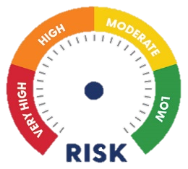
NIST CSF 2.0 Risk Assessment Results Gaps
Observation | Risk Statement | Threats | Vulnerabilities | Risk | Action Plans | Cost Estimate
MFA missing on internet facing web applications | The absence of Multi-Factor Authentication (MFA) on critical external websites accessed by providers, members, and brokers significantly heightens the risk of unauthorized access, compromising sensitive information and critical systems. | Credential Theft, Brute Force Attack, Insider Threats, Man-in-the-Middle (MITM) Attacks, Phishing Attacks, Exploitation of Weak Authentication Protocols | Weak password policies, single factor authentication, unpatched software, Lack of MFA, inadequate user education, insecure storage credentials, lack of monitoring and logging. |  | This observation is on the tactical roadmap to mitigate in 2024. | $$$*
SAMPLE COMPANY has ePHI production data in the test environment. This is inadequate process. | The presence of production ePHI data in the test environment significantly increases the risk of data breaches and unauthorized disclosure of sensitive patient information. Unauthorized access to ePHI also raises the potential for identity theft, medical fraud, and data corruption, compromising the integrity and confidentiality of patient data. | Data breaches, unauthorized access, malware attacks, insider threats, physical theft, ransomware, data tampering | Weak encryption, improper access controls, outdated storage solutions, lack of monitoring, inadequate backup, poor data management policies, insufficient incident response |  | There are mitigating controls in place, such as a workforce needs access to the network and access to the test environment. | $$$
SAMPLE COMPANY network is flat, which means that if one device falls victim to malware, it could impact all other devices on the network. | An unsegmented network significantly elevates the risk of widespread cybersecurity incidents due to the lack of isolation between different parts of the network. This configuration allows an adversary who gains access to any single point of the network to potentially move laterally across the entire system, accessing sensitive information and critical resources. | Unauthorized access, data breaches, malware, insider threats, network attacks, system compromise, exploitation of vulnerabilities | Weak access controls, insufficient network segmentation, poor monitoring, outdated security protocols, inadequate logging, lack of multi-factor authentication, insufficient training |  | There is a micro-segmentation project in progress to mitigate this risk. | $$
SAMPLE COMPANY does not have data de-identification in the test environment. | Not having ePHI de-identified in the test environment significantly increases the risk of unauthorized access and exposure of sensitive patient information. financial penalties, and loss of patient trust. Unauthorized access to identifiable ePHI can facilitate identity theft, medical fraud, and misuse of personal health information, compromising patient privacy and data integrity. | Insider threats, unauthorized access, malware, data tampering, process hijacking, data leaks, exploitation of vulnerabilities | Insecure processing environments, lack of monitoring, insufficient access controls, outdated systems, weak application security, poor data handling practices, inadequate encryption |  | There are mitigating controls in place, such as a workforce needs access to the network and access to the test environment. | $$$$
The cost are qualitative measurements that will require research for quantitative costs
* $ - Minimal Cost, $$ - Moderate Cost, $$$ - Significant Cost, $$$$ - Major Cost
Notes:
This is a draft of our current metrics. The assessment is still underway, We’ll need to take a look at some deficiencies and determine if we want them to be at a 4 or is a 3.5 or 2.7 good enough. Those are going to be questions and answers once the assessment is completed to determine how we deal with the risk
Govern
Update information security policies – This is in progress
Identify
Limited data classification, record retention criteria, and data destruction implementation – We need to evaluate this one based on our P32 acquisition
Limited security architectural and data flow documentation – This is in progress of being developed
Amysis has limited user roles (e.g., no RBAC) – This is role based access control. There are two roles in Amisys which prevents separation of duties.
Protect
ePHI in test environment – We need to evaluate this one based on our P32 acquisition
Some external websites missing MFA – This is being addressed in the MFA project
Flat network – This is being addressed in the Micro Segmentation project
Missing standards for consistent control implementation – This needs to be put into a project
Limited code scanning – This is being addressed
CSM is running on old technology - – We need to evaluate this one based on our P32 acquisition
Clear text passwords on shared drive – This is being addressed in the privilege access management project
3rd Party Risk Assessment improvements – This needs to be evaluated at the Vendor Management meeting
Detect
Limited security monitoring (e.g., SIEM monitoring) (being addressed with Rapid 7 MDR capabilities) – This is being discussed with a Managed Detection and Response solution with Rapid 7

Slide 5
2024 Tactical Information Security Technology Implementation Roadmap
MAY
JUN
JUL
AUG
SEP
OCT
NOV
DEC
Security Projects
Privilege Access Management Protect
10%
Prod DB (Amisys)
Palo Alto Firewall Protect
80%
MFA on Externally Facing Web Apps Protect
0%
Data Loss Prevention Detect
0% DNS
Web Application Firewalls Protect
0%
Internal Penetration Testing Detect
95%
Extended Detection & Response (XDR) Detect & Respond
0%
Server 2012 Upgrade Identify & Protect
25%
Zero-Trust Endpoints Protect
Discovery
Micro-Segmentation Protect
0% Environmental Level
0% Tiering Level
Layer 7 API Gateway Protect
90%
Notes:
Layer 7
Upgrade to Latest Version of Layer7 API Gateway/Firewall
Environment Build out complete
Unit Testing Complete
System Testing 90% Complete
User Testing Underway
Palo Alto
Replacement of Cisco ASA Firewalls
Administrative Training Complete
Environment Complete
Unit Testing Complete
System Testing w/ Rule Enhancement 80% Complete
User Testing Begins July 8th
Business Continuity Planning
BCP Planning Exercise Read Out Conducted
Review of BCP/BIA Ownership Complete
Action Items Assigned
Update of Existing BIA Documents in PowerDMS
Includes Call Trees, Point Person & back up and Key Vendors
Review for Completeness
Next Monthly Meeting July 8th
Disaster Recovery Exercise
Planned for 3rd Qtr
Focus on Amisys
Testing of VDI
Security Mandatory Training
99% Completion
AI Steering Committee
Charter & Policy Finalized
5 Submissions for MS Copilot Assessment
Risk Management – Approved
Compliance - Pending
IT Security - Pending
Marketing & Communications - Pending
IT End User Computing (Desktop) - Pending
Meeting Scheduled w/ MS to Coordinate/Plan Setup
Next Monthly Meeting July 22nd
Managed Detection and Response
Rapid7
Tools to assist w/ Detection and Prevention
Incident Response and Forensics
SIEM with advanced analytics
24x7x365 SOC Monitoring

Slide 6
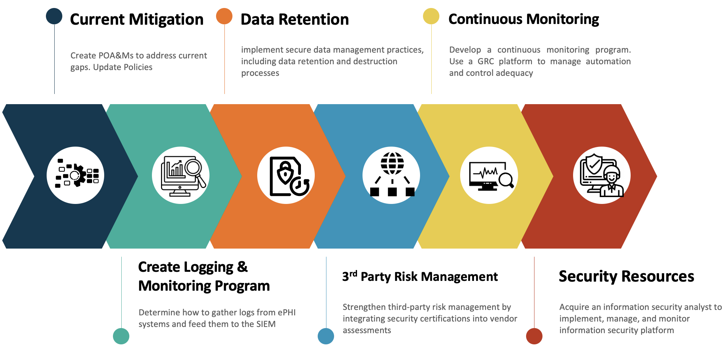
2024/25 Strategic Information Security Technology Roadmap
Current Mitigation: Continue to follow through with the tactical information security plan.
Logging & Monitoring Program: Develop a thorough logging and monitoring program to ensure threats and vulnerabilities are identified quickly to address risks such as ransomware attacks.
Data Retention and Destruction Program: Develop a data retention and destruction program to identify data that needs to be kept for a certain timeframe and destroyed after that timeframe. For example, how long should we keep email.
3rd Party Risk Management: Enhance the vendor management program to include the review of applicable security certification, if feasible.
Continuous Monitoring Program: Develop a continuous controls monitoring program to ensure controls stay adequate. This can be done through Governance, Risk and Compliance (GRC) platforms, such as ControlMap.
Security Resources: Acquire an additional security analyst to ensure that the implementation of security controls is managed and monitored continuously.
Notes:
No other program I’ve even seen had a 0 click rate

